Slide 1
Bishop Lonsdale C of E primary
Active schools programme – A whole school approach to physical activity
 | March 2018 – April 2019
The Active school programme supports the following key indicators: Key indicator 1: The engagement of all pupils in regular physical activity – Chief Medical Officer guidelines recommend that primary school children undertake at least 30 minutes of physical activity a day in school Key indicator 2: The profile of PE and sport being raised across the school as a tool for whole school improvement Key indicator 3: Increased confidence, knowledge and skills of all staff in teaching PE and sport Key indicator 4: Broader experience of a range of sports and activities offered to all pupils This year we have accessed through the Active School programme:
April - Aug | Sept - Dec | Nov - March | April to June
Staff meeting – Active School programme launch Audit and development plan produced Baseline assessments across school Height, weight, fitness and physical activity levels measured Teacher audit to capture staff confidence in delivering PA in the curriculum ‘Active School’ assembly to launch programme and an active challenge set for children Lunchtime games sessions and resource | Second staff meeting (training session) Universal Daily Physical Activity programmes: making our school day more active Rammie’s Daily Mile Active learning ideas for across the curriculum Interventions: Physical Literacy intervention year 2 + Play to learn – curriculum resource to support physical literacy and fundamental movement skills in KS1. Training and mentoring for one member of staff (once a week for 6 weeks) Rammie’s Healthy hero lunchtime club - Healthy lifestyle programme for targeted pupils who are overweight and/or inactive (8 weeks) Piloted Rammie’s Little Movers – A six week programme to support good physical development in the early years, developing an understanding of the importance of physical activity and healthy eating, for happy brains and healthy bodies | Continuation of universal programmes Access to Live IT programme – to support children who are overweight, and their families (one year support) End Feb – Re assessment across school to measure impact | Data analysed and fed back to schools Outcomes for Sport premium reporting identified Next steps identified
Ongoing 6 x support and planning meetings Development of physical activity policy Work with MDS to support active lunchtimes Parent workshops/events – linked to Live IT programme Support from DCCT partners: School Sport Partnership and Premier League Primary Stars

Slide 2
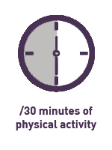
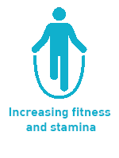
Active School report
Active schools programme – Impact
Under the Ofsted Schools Inspection Framework, inspectors will assess how effectively leaders use the Primary PE and Sport Premium and measure its impact on outcomes for pupils, and how effectively governors hold them to account for this.
Key indicator 1: The engagement of all pupils in regular physical activity
Daily physical activity increased by 62 minutes across the school day including more active lunchtimes
7 out of 7 children improved their physical development
52% of 145 children tracked increased the distance ran in ten minutes by the second assessment. This may have been higher but second assessment took place on the last day of term when some children were tired.
10 minute run | Distance run metres | % of children
Baseline | Below 799 m | 7%
 | 800 m to 1599 m | 93%
 | 1600 m + | 0%
Second measure | Below 799 m | 4%
 | 800m to 1599 m | 91%
 | 1600 m + | 5%
Table to show the % of pupils who ran below and above the average distance of 1176m (from the Active school cohort of 6 schools) | Percentage of children (Baseline) | Percentage of children (Second measure)
Below average | 73% | 69%
Above average | 27% | 31%

Slide 3
Active School report
Active schools programme – Impact
Under the Ofsted Schools Inspection Framework, inspectors will assess how effectively leaders use the Primary PE and Sport Premium and measure its impact on outcomes for pupils, and how effectively governors hold them to account for this.
Key indicator 2: The profile of PE and sport being raised across the school as a tool for whole school improvement Staff reported: ‘There has been significant improvement in handwriting linked to the improvement in physical development. One child sharing her ‘Improved’ handwriting with the Head told them ‘It was because of physical literacy’ Key indicator 3: Increased confidence, knowledge and skills of all staff in teaching PE and sport Key indicator 4: Broader experience of a range of sports and activities offered to all pupils
% of staff saw the following changes in pupil behaviour after physical activity
More alert and ready to learn 83%
Better engaged in lessons 67%
Happier 100%
Increased stamina 100%
83 % of staff said they felt more confident to deliver physical activity as a result of the Active school programme
Physical Literacy training delivered to key staff and all staff reported feeling more confident to support pupil’s physical literacy
Two staff meetings to increase staff knowledge and understanding of the importance of physical activity and ways to increase physical activity across the school day
Physical Literacy/Play to Learn and Rammie’s Little Movers delivered in school with KS1 staff
Daily Mile running across school
Short bursts of physical activity introduced in lessons as part of learning or an active stop
Family fitness session run for children and their parents
Family healthy lifestyle workshop run with parents
New lunchtime games introduced as part of Rammie’s Healthy Heroes

Slide 4
Active school report
Active schools programme – Impact
Key indicator 4: Broader experience of a range of sports and activities offered to all pupils - 41 children attended Rammie’s Healthy Hero lunchtime club - 38 children attend the Live IT child weight management programme Staff said: Parents said:
‘The fact that it is Derby County has had a high impact on increasing children’s physical activity levels’
‘Children have really benefited from being outside more and they look forward to being active’
‘I’ve seen an increased level of fitness, the children now understand that you are meant to feel hot and puffed out’
‘There is less fussing in lessons after being active’
The best bits about the parent workshop was:
‘when my child tried spinach’
‘Making and eating different healthy foods’
Making our own food with the children’
‘The bush tucker trial’
‘Seeing the amount of sugar in the foods’
The activity that I’ll try:
‘Letting my son make his snacks’
‘Blind tasting of new foods’
‘Trying new foods with my child’
It would have been even better if:
‘I’d known this before’
‘It could have been outside’
‘The session was longer’

Slide 5
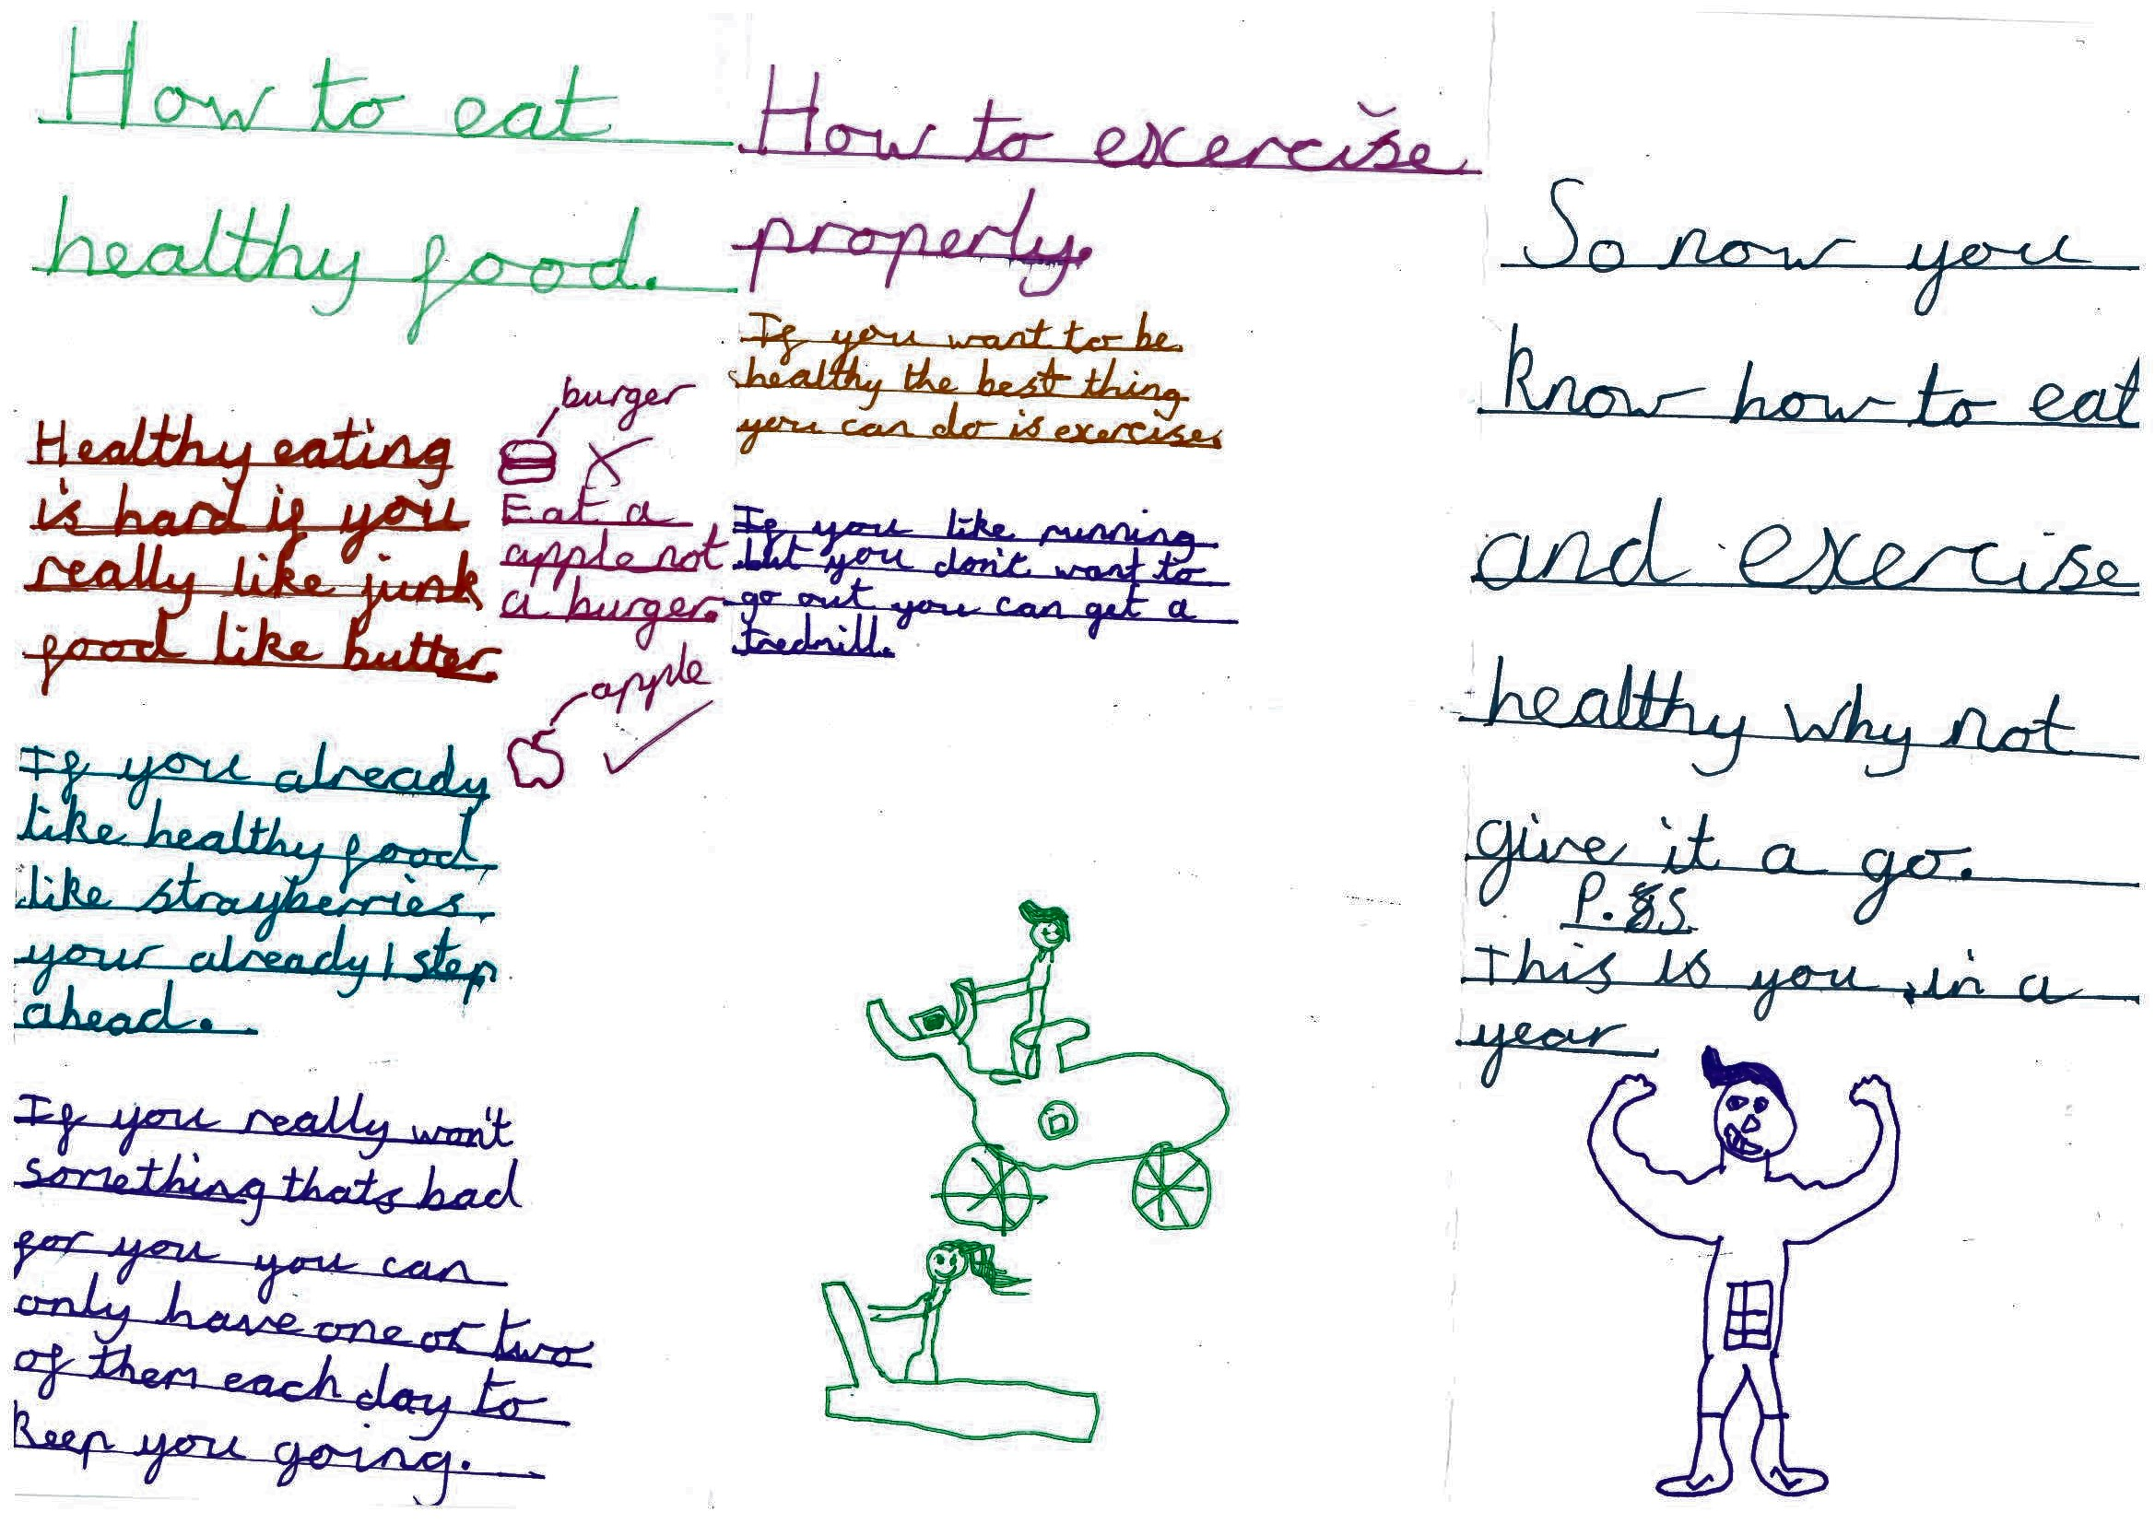
Active school report
Active schools programme – Impact
Key indicator 4: Broader experience of a range of sports and activities offered to all pupils Pupils surveyed said since the Active school programme: Example of learning from Rammie’s Healthy Heroes lunch club:
They felt more confident to have a go at something new
They felt fitter and stronger
They were happier
They enjoyed playing new games and having fun
They’ve become more active by doing the Daily Mile, running around more at lunchtime and break and doing more exercise at home.
Examples of some of the new things they’d tried outside of the school day were: cheerleading, boxing, gymnastics, football, rainbow club, boy’s brigade and using the rowing machine at home.
Next Steps:
Share good practise from Play to Learn approach and Rammie’s Little Movers with all staff Continue with the Daily Mile and short bursts as part of learning and as active brain boosts Daily Mile class competition Share findings from Active school report with all staff Physical literacy intervention to continue Rammie's Little Movers for next year's cohort Rammie's Healthy Heroes 2 – focus on healthy eating

